Slide 1

Session 1
Introduction To Selenium

Slide 2
Topics Covered
What is Selenium?
Selenium’s Tool Suite
Choosing Your Selenium Tool
Programming Languages & Frameworks
Browsers and Environment Support
Selenium and UFT(earlier QTP)

Slide 3

What is Selenium?
Selenium is an open-source and a portable automated software testing suite for testing web applications across different browsers.

Slide 4
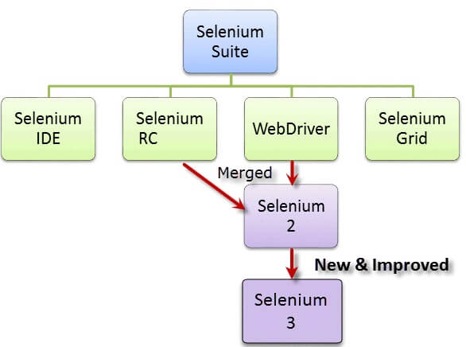
Selenium’s
Tool Suite

Slide 5
Choosing Your
Selenium Tool
Get started with Selenium IDE. If not experienced with a programming or scripting language to get familiar with Selenium commands.
To effectively use run your tests using Selenium 3 in conjunction with one of the supported programming languages.
Developers are planning on the Selenium-WebDriver API being the future direction for Selenium.

Slide 6
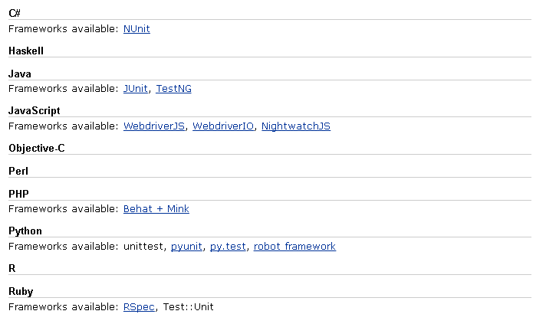
Programming Languages
& Frameworks

Slide 7
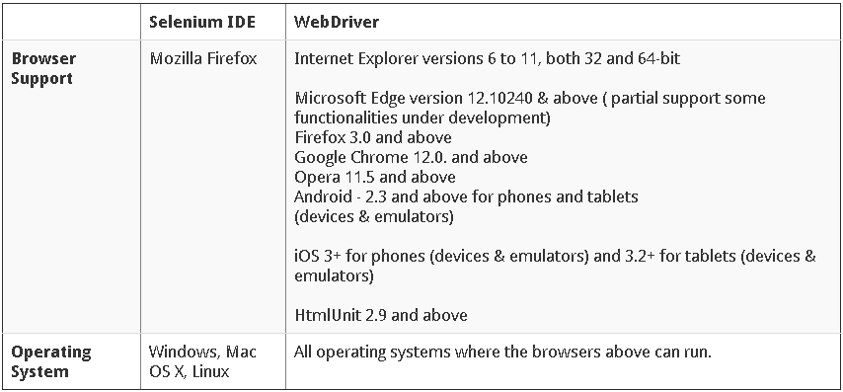
Browsers and Environment
Support

Slide 8
Selenium and
UFT(earlier QTP)
Selenium | UFT
Open source, free to use. | Commercial
Can test Web, Mobile, Windows(Limited Support) | Can test Windows, Web, Mobile
Can execute tests while the browser in minimized. | Application needs to be visible on the desktop.
Supports various operating systems | Available in Windows only

Slide 9


Slide 10
Knowledge Check
What is Selenium?
What are different tools available in Selenium?
Top 2 Programming Languages used for Selenium WebDriver?
Selenium is built using What?
Which kind of Browsers are supported by Selenium?

